Slide 1
HydroHack: All-in-One Water Quality Sensor
By: Anirudh Chintaluri, Anurag Perakalapudi, Dhruv Chandna, Aneesh Kalla

Slide 2
What’s going on?
Reports have stated that 50% of America’s water is too polluted for drinking, swimming, or fishing.
The US is lacking in water infrastructure
Much of our water passes through lead pipes
Too much exposure to lead leads to lead poisoning — poses a serious health risk

Slide 3
What’s this sensor meant for?
Detecting water quality to determine whether or not it’s safe to drink or not
Measures several water quality metrics:
pH
Conductivity of water
Hardness of water
Chlorine
Sulfates
Total Organic Carbon
Turbidity

Slide 4
AIO vs Current Tech
Both are compatible with Raspberry Pi
Current water quality technology requires multiple sensors being plugged into multiple analog pins for each sensor
HQuality Pro+ incorporates all of this water quality tech into a single electronic component and connects to only one pin
This makes it more efficient and gives you more space for other sensors on your Raspberry Pi board

Slide 5
Machine Learning Implementation
We created a Machine Learning models to evaluate results from the AIO sensor to determine safety of water
Made Neural Network and Random Forest
68% accuracy predicting safe or unsafe
CreateML
95% accuracy on the purest water

Slide 6
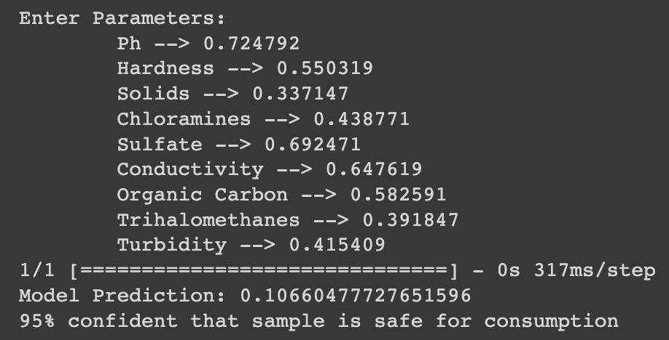

Slide 7
Design Layout
Side view
Turbidity sensor
TOC sensor
Hardness sensor
Turbidity sensor
Conductivity sensor
pH sensor
Chlorine conc. sensor
Sulfate conc. sensor
Bottom view
(to be inserted into water)

Slide 8
Citations
https://thehill.com/changing-america/sustainability/environment/600070-about-half-of-us-water-too-polluted-for-swimming/
https://www.ncbi.nlm.nih.gov/pmc/articles/PMC3775162/#:~:text=%5B1%5D%20Among%20them%20a%20good,renal%20dysfunction%20and%20so%20on.
https://www.epa.gov/sites/default/files/2014-09/documents/support_cc1_sulfate_healtheffects.pdf
https://www.kaggle.com/datasets/adityakadiwal/water-potability
https://www.lenntech.com/turbidity.htm#:~:text=%2D%20Urban%20runoff-,Which%20is%20the%20maximum%20allowed%20turbidity%20in%20drinking%20water%3F,ideally%20be%20below%201%20NTU.

Slide 9
THANKS
Do you have any questions?
addyouremail@freepik.com
+91 620 421 838
yourcompany.com
Please keep this slide for attribution

